Slide 1

March 7 – The Future of Agile Testing
How Inflectra performs Agile Testing – Adam Sandman

Slide 2
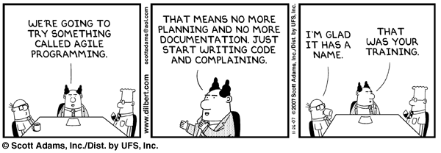
Disclaimer!!!
This is not a lecture on the future of agile testing, just some ideas and stories from our experiences. We look forward to a discussion!

Slide 3
Agenda
Who We Are
How Has Agile Impacted Testing
Where Does Testing Go From Here?
Questions

Slide 4
Background – Who Are We?

Slide 5
OK - What Does Inflectra Actually Do?
KronoDesk®
IT Support & Help Desk Ticketing
SpiraTeam®
SpiraTest®
Requirements & Test Management
SpiraPlan®
Project Management & Defect Tracking
TaraVault™ - Source Code Hosting
Rapise®
Test Automation Platform (Web, GUI, Services)

Slide 6
What Was Testing Like Pre-Agile?
Business analysts write requirements
Requirements signed off by customer
Testers write scripts and get sign-off
Developers design system, update requirements
Developers develop system, update requirements
Testers update test scripts
Testers run scripts, following steps, log bugs
System released (if all goes well)

Slide 7
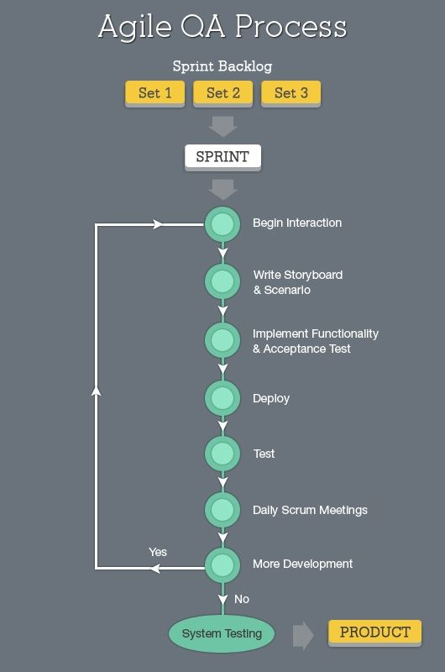
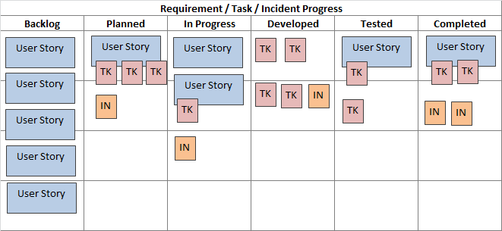
Agile & Testing – What Pinterest Says

Slide 8
Our Development Process
Requirements, User Stories, etc.
Acceptance
Tests
Session
Testing
Source Code Mgt.
Automated
Tests (Checks)
Test Environments
Subversion
Git
Continuous Integration
(Jenkins)
Installation
Process

Slide 9
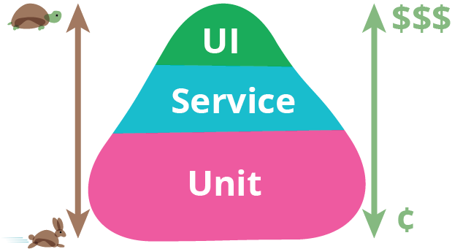
The “Price” of Testing

Slide 10
So How Do We Do Testing?
We have automated unit tests written in C# executed as part of the build – report back to SpiraTeam.
We have automated REST and SOAP API tests that use Rapise to automatically test our endpoints.
We don’t have detailed written test scripts, we use requirements and generate session-tests from them.
  We have developers cross-test
  We have dedicated QA team that are NOT developers
We plan on adding some basic UI automated testing to cover simple, repetitive scenarios

Slide 11
Future Testing Roles
Business Analysis
  If you like the business side, focus on user stories and acceptance tests
Automated Checks
  If you like the code, consider being an automation engineer.
Exploratory & Session Testing
  If you can find bugs without trying, harness your intuition with session-based testing

Slide 12
Questions? Suggestions?

Slide 13
Introducing: Elise Brooks
Head of Quality Assurance @ Inflectra

Slide 14
What is Session-Based Testing
Applies some basic structure to exploratory testing
Time-boxed session where you focus on a specific objective or set of user stories
Test Cases are basically just a description of the objective or area being tested
  You can link it to the requirements and user stories
  Measuring functionality coverage is a good thing!
Executing a test case means following an unstructured path that tests the objective, recording all observations, not just problems.
  Even if functionality is not finished, the observations are useful to the developer

Slide 15
The Challenges of Session Based Testing
Sometimes it’s hard to know if it’s broken or ‘just not done yet’
Observations may not be actual issues
The Units Tests all Pass, Why is it Broken?
We can both read the test run report and get completely different information!
Test Runs end up being a lot of unrelated issues that can be hard to trace.
When to transition from recording test runs to logging defects?

Slide 16
Questions? Suggestions?

